Slide 1
A.L.E.T.E
Academic Law Enforcement Training Exchange

Slide 2
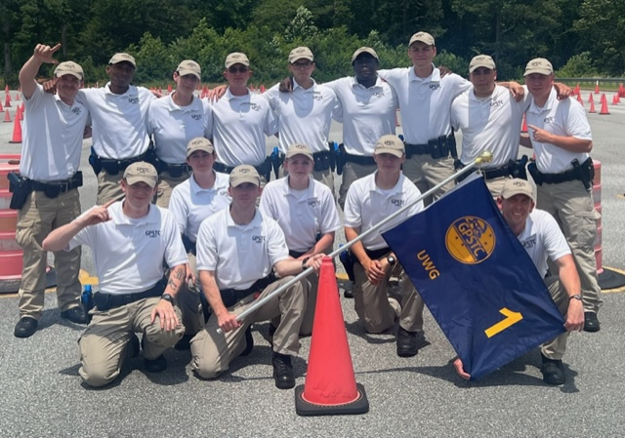
The Program
Partnership Between GPSTC and UWG
Training is held on UWG campus except for EVOC
Full 12-week traditional academy training
Students receive up to 15 credit hours
Students can use financial aid to pay for program
$3,500

Slide 3
Benefits
For Students
Graduate UWG with degree and POST certification
Complete academy on campus
Higher base pay and singing bonuses
Work Ready
For Agencies
Cost savings on pre-service new hire
Time and resources spent on vetting
Students had the traditional academy experience instead of the training being spread out over their degree

